Slide 1
Interaction regimes of unequal viscous vortex pairs in the presence of background shear
Patrick Folz
Keiko Nomura
University of California, San Diego
67th Annual Meeting of the American Physical Society
Division of Fluid Dynamics

Slide 2

Interaction of Co-rotating Vortices in Viscous Fluid
E.g. 2D turbulence: merging of co-rotating vortices considered to drive inverse energy cascade
Majority of previous studies have considered isolated symmetric pairs
  Critical merging criterion: (a/b) > (a/b)_{cr}
More typical are asymmetric pairs, whose interactions and criterion are more complex
What is the effect of the surrounding vortices?
  Previous research has considered linear shear, but only symmetric inviscid pairs
Asymmetric
pair
Still from 2D turbulence movie, Dr. Juan Carlos Del Alamo, http://maeresearch.ucsd.edu/~jalamo/MAE_223/Assignments.html
Objective: Classify and study interactions of symmetric and asymmetric viscous pairs in shear

Slide 3
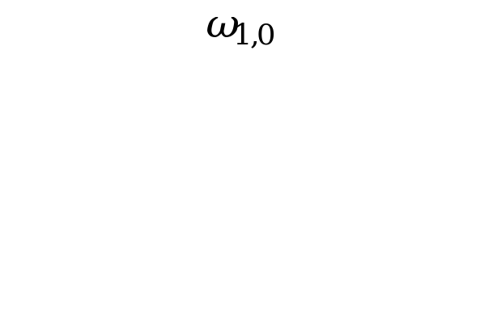
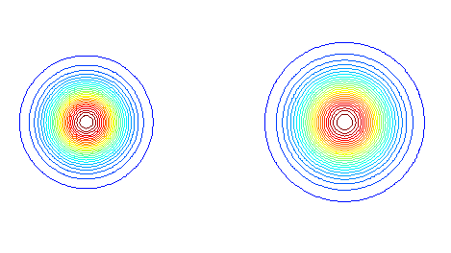
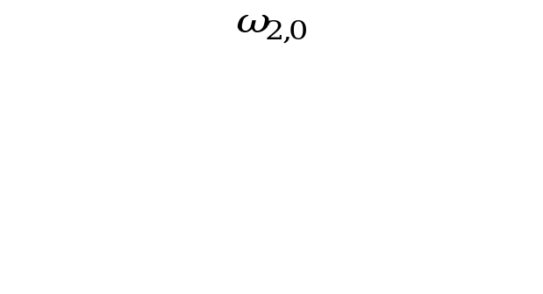
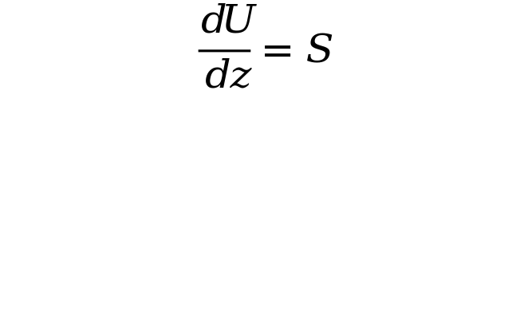

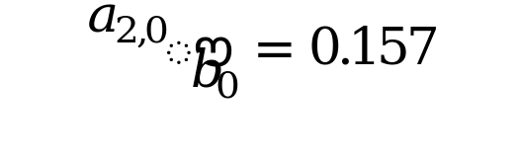
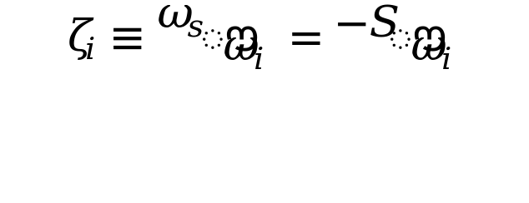
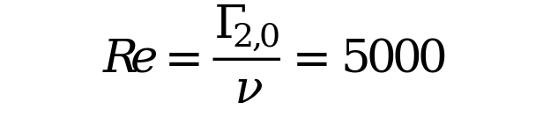
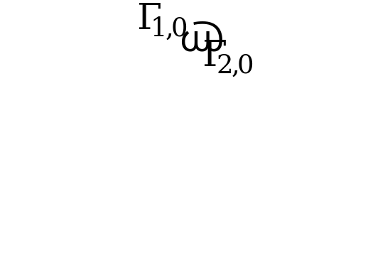
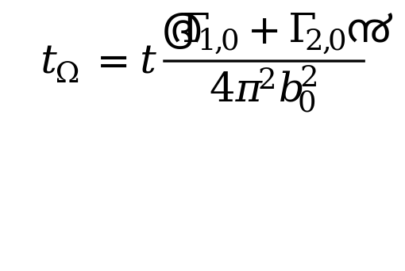
Approach: 2D numerical simulation of a co-rotating vortex pair
Flow Setup and Parameters
b₀
2a_{1,0}
2a_{2,0}
Flow Parameters:
Aspect
Ratio:
Shear
Strength:
Reynolds
Number:
Circulation
Ratio:
Characteristic Time:

Slide 4
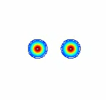
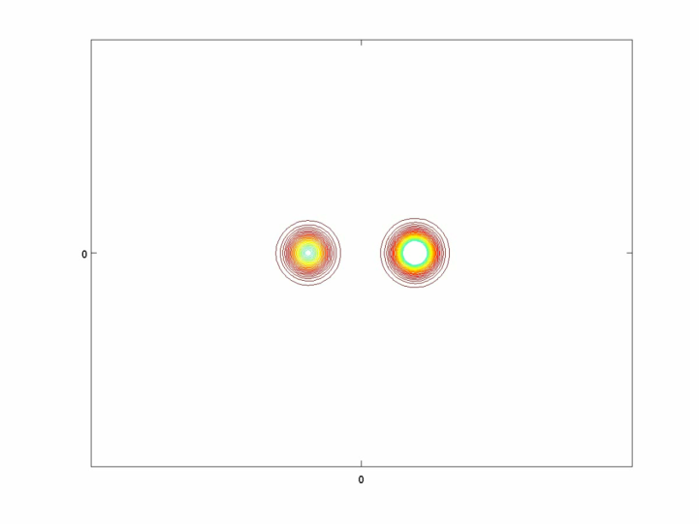
Vortex Interactions
Symmetric Pair
No Shear
Asymmetric Pair
Shear (Adverse)

Slide 5
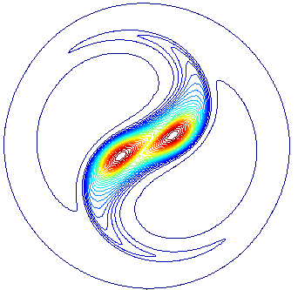
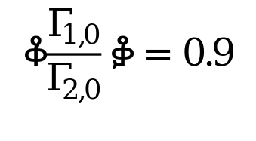

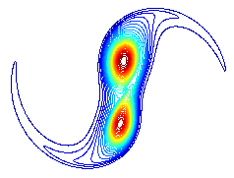
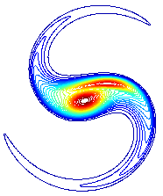
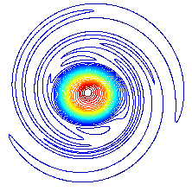

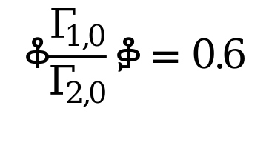

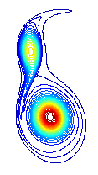
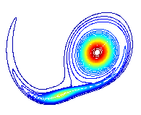
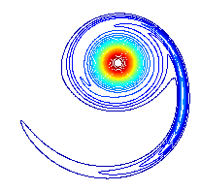

Viscous Vortex Pairs (Without Shear)
Symmetric pairs will eventually merge into a single vortex since viscous core growth a(t) will cause attainment of critical aspect ratio (a/b)_{cr}
Both cores mutually strained, detrained/entrained, destroyed
Asymmetric pair interactions depend on relative timing of core detrainment and destruction, but eventually result in a single vortex
If both vortex cores detrain, stronger vortex entrains weaker vortex
If the weaker core is detrained sufficiently earlier, it can be strained out and destroyed – no significant entrainment occurs
(Brandt and Nomura, JFM, 2010)

Slide 6
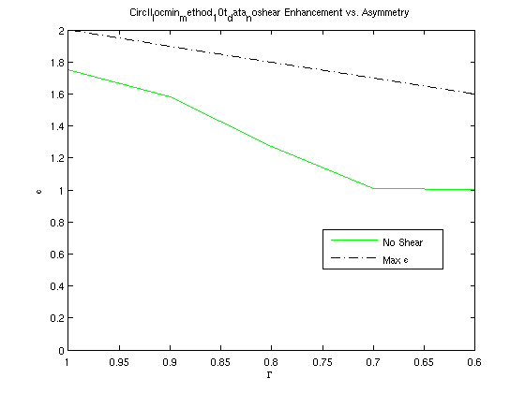

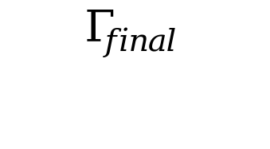
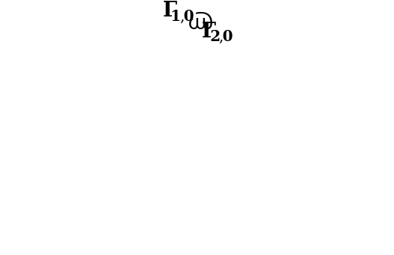
Viscous Vortex Pairs: Interaction Outcome
Symmetric pairs will eventually merge into a single vortex, which is enhanced relative to either of the original vortices, i.e. has greater circulation
Asymmetric interactions also result in a single vortex, but with varying levels of enhancement
ε
Symmetric
evaluated at time of destruction of weaker vortex
Enhancement
No Enhancement

Slide 7
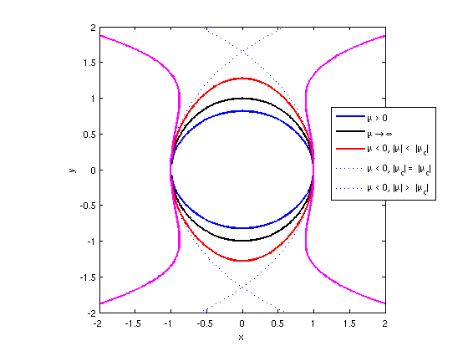
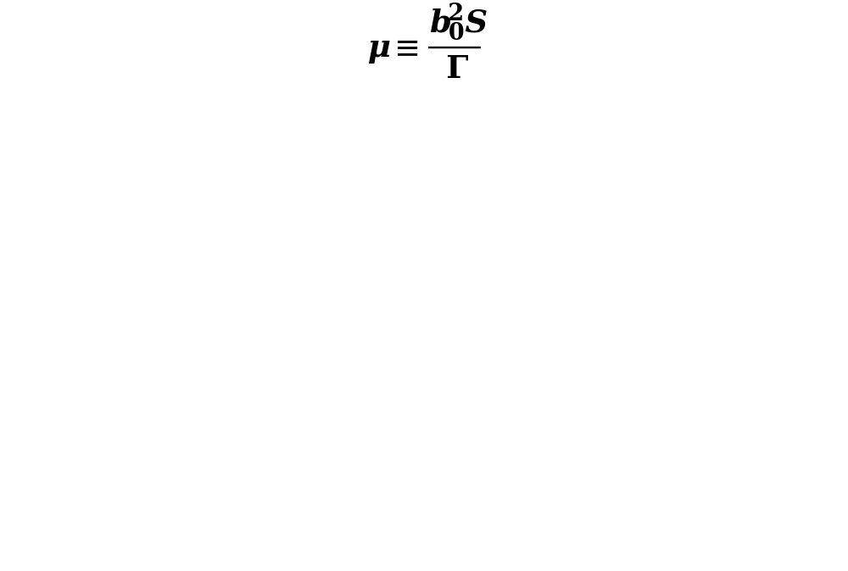
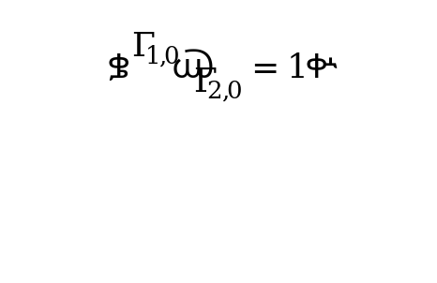

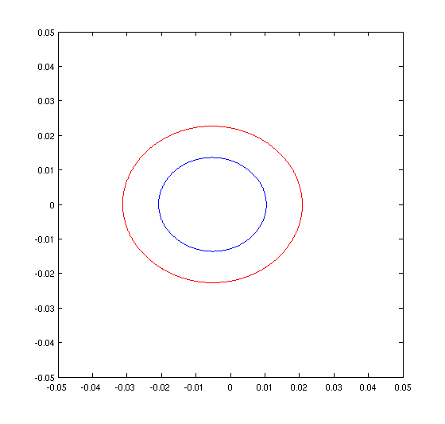
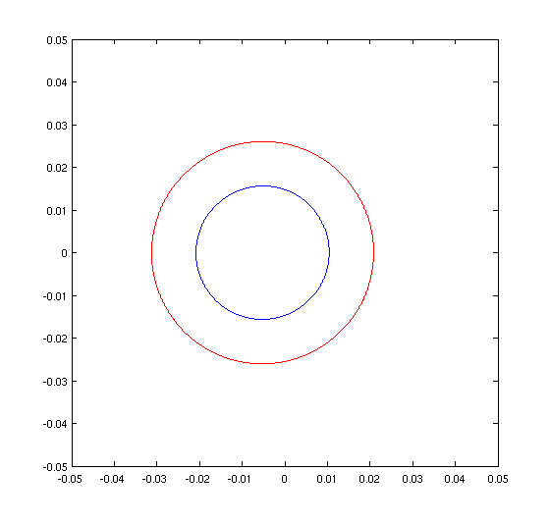
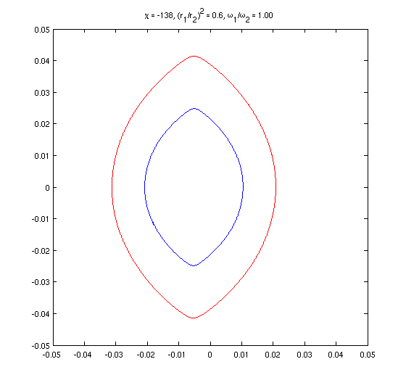
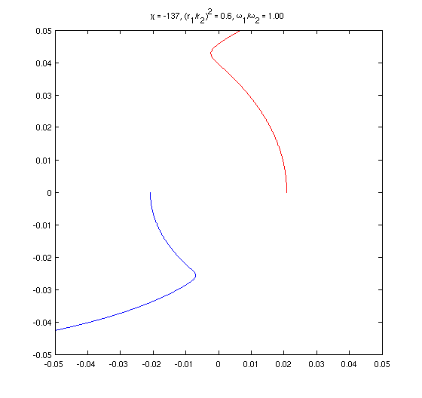

Effect of Shear: Point Vortex Model
Trajectories of two point vortices in uniform shear can be computed for a range of point vortex strengths (Γ_{i}) and shear (S)
Symmetric:
Let
Favorable Shear (μ > 0):
Closed orbit with minimum b(t) at ±
= 0
No Shear (μ = 0):
Circular orbit
Adverse Shear (μ < 0):
Closed orbit with maximum b(t) at ±
Weak (|μ| < |μ)_{c}|:
Strong (|μ| > |μ_{c}|):
Based on the method described in
Kimura and Hasimoto, JPSJ, 1985 and Trieling et al., Phys. Fluids, 2010
Separative motion
Asymmetric:
Shear Sense:
Favorable
No Shear
Weakly Adverse
Strongly Adverse
Shear causes separation distance to vary: b = b(t)

Slide 8
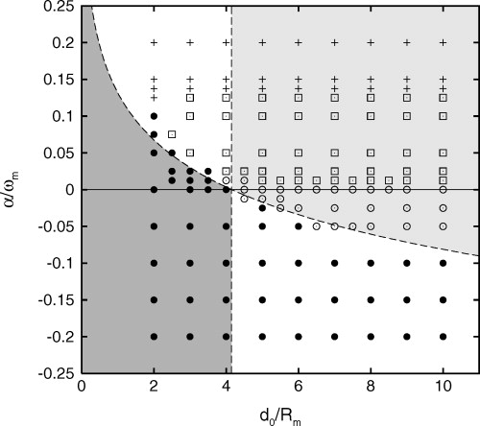
Inviscid , Symmetric Vortex Pairs in Shear
(Trieling et al., Phys. Fluids, 2010)
(d/R)_{cr}
Simulations of inviscid finite-area Gaussian (Lamb) vortices in background shear identified 4 interaction regimes:
Adverse
I.
II.
Separation with elongation (+)
Separation without elongation (□)
Periodic motion (○)
Merger (●)
III.
Favorable
IV.
Regime boundary between merger and no merger predicted well by point vortex model with shear (b = b(t)) and (a/b₀)_{cr} (here d₀/R_{m}) for non-sheared vortices
Regime diagram for Lamb vortices in shear. Reproduction of Fig. 9 from Trieling et al. 2010

Slide 9
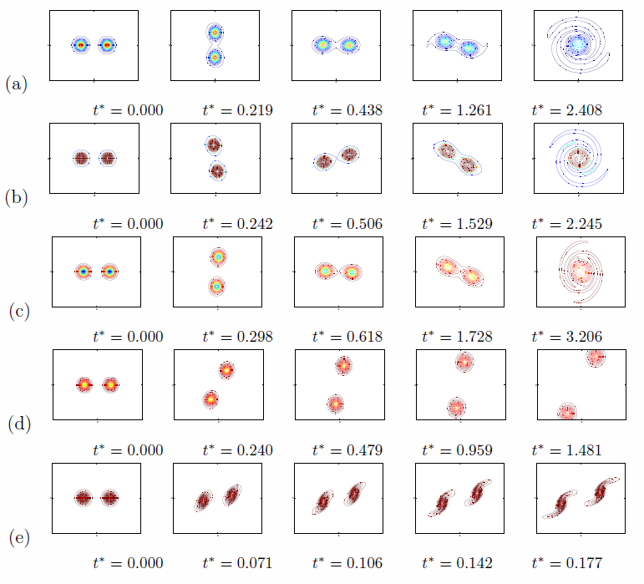
Viscous, Symmetric Vortices in Shear: Flow Regimes
Shear Sense:
Favorable:
No Shear:
IV.
Weakly
Adverse:
Merger
Strongly
Adverse:
II.
Separation
Very
Strongly
Adverse:
I.
Viscosity precludes indefinite periodic motion (Regime III)

Slide 10
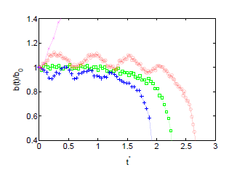
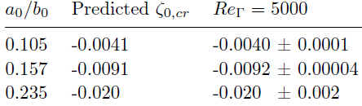
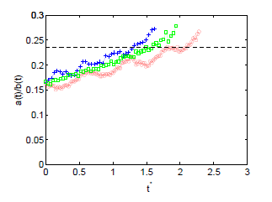
Viscous, Symmetric Vortices in Shear: Flow Processes
Observations:
Primary effect of shear is variation of b(t), as described by point vortex model
  Induced strain ~ 1/b(t)
Favorable/adverse shear may accelerate/delay detrainment process and subsequent merger relative to no-shear case
Separation occurs for sufficiently strong shear
  ζ_{cr} = -S/ω₂ delineating separation and merging is well-predicted by point vortex model
Merging initiated when (a/b) reaches (a(t)/b(t))_{cr} ≈ 0.235 (value for no-shear case) is reached

Slide 11
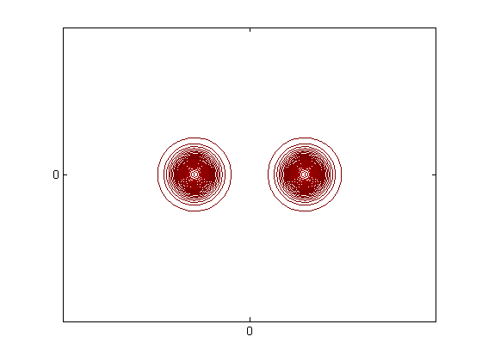
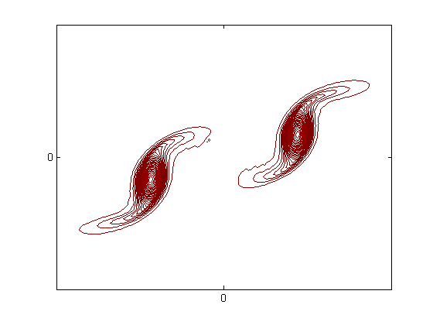
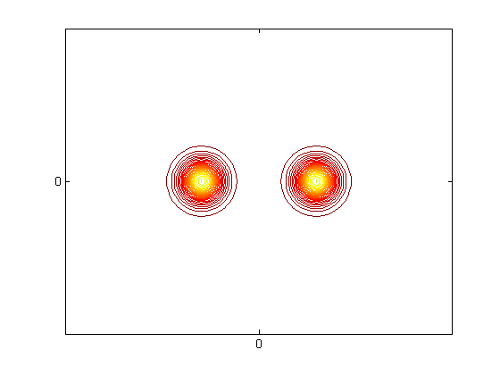
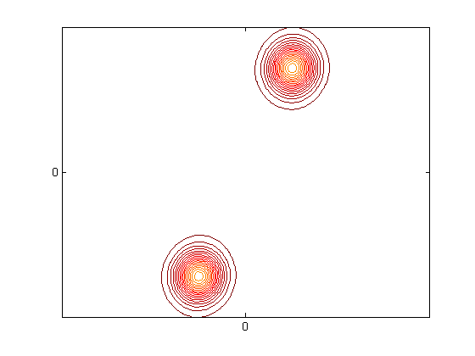

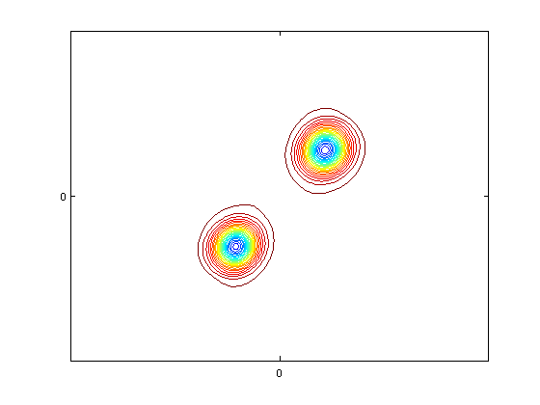
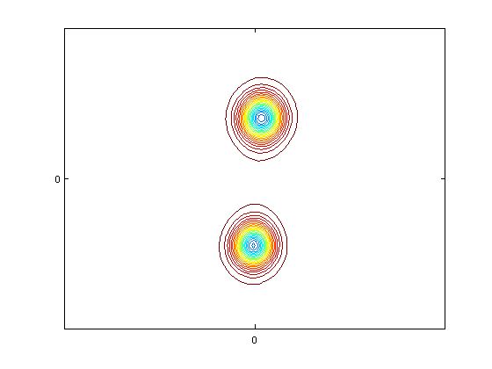
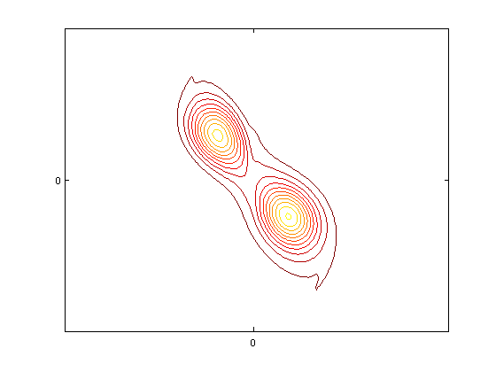
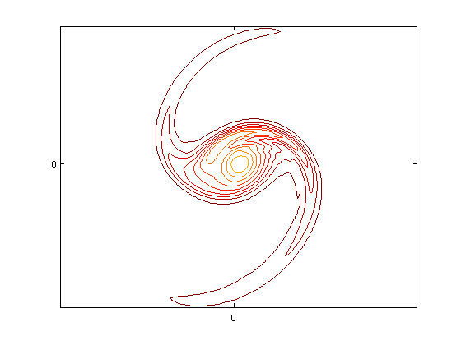
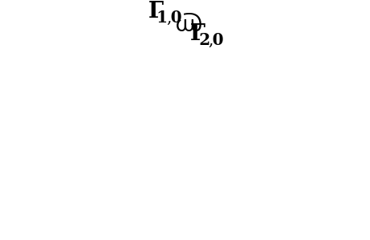
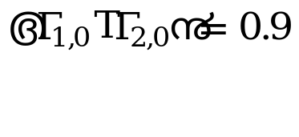
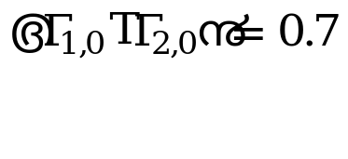
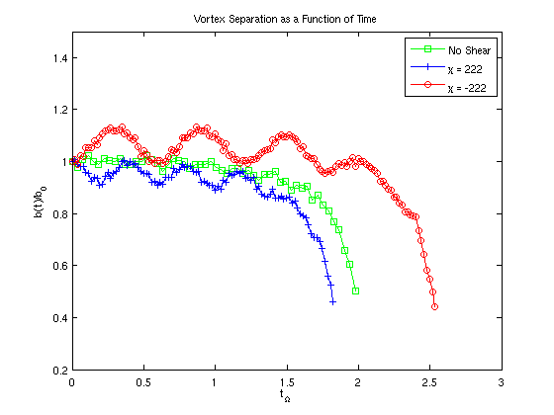
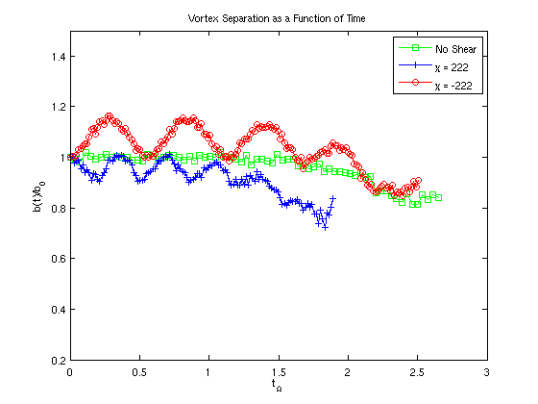
Viscous, Asymmetric Vortices in Shear: Flow Processes
Separation w/o Elongation:
Observations:
Separation w/ Elongation:
Again, variation of b(t) due to favorable/adverse shear causes acceleration/delay of detrainment process relative to no-shear case
Merger:
ζ_{cr} varies with as predicted by point vortex model
Λ | Predicted ζ_{cr} | Empirical ζ_{cr}
1.0 | -0.0091 | -0.0093 ± 0.0001
0.9 | -0.0086 | -0.0089 ± 0.0002
0.8 | -0.0081 | -0.0084 ± 0.0002
0.7 | -0.0077 | -0.0077 ± 0.0001
0.6 | -0.0072 | -0.0074 ± 0.0001
Objective: characterize interactions of two viscous unequal vortices in background shear
Approach: 2D numerical simulation of a co-rotating vortex pair

Slide 12
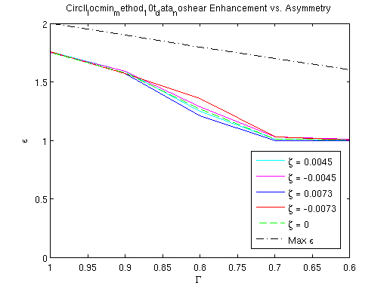
Viscous, Asymmetric Vortex Pairs in Shear: Enhancement
Observations:
Shear alters enhancement at moderate
  Strong Adverse shear increases enhancement
  Strong Favorable shear reduces enhancement
The presence of shear never produces enhancement when the equivalent-
no-shear case does not
ε
Symmetric
Enhancement
No Enhancement
Objective: characterize interactions of two viscous unequal vortices in background shear
Approach: 2D numerical simulation of a co-rotating vortex pair

Slide 13
Summary
  Symmetric Pairs: merger occurs for (a/b) < (a/b)_{cr}
    Both vortices detrain, are mutually entrained and destroyed
    Form single vortex with ε ~ 2
  Effect of viscosity: a = a(t) grows and (a/b)_{cr} eventually reached
  Effect of asymmetry: outcome altered by relative timing of core detrainment and destruction
    Form single vortex with 1 ≤ ε < 2
  Effect of shear: b = b(t) causes variation in induced strain
    Zeta ≤ zeta_cr: separative motion (no merger)
    Zeta > zeta_cr: single vortex forms, enhancement altered

